Slide 1
DTS205TC High Performance Computing
Lecture 4 Network 2
Di Zhang, Spring 2024

Slide 2
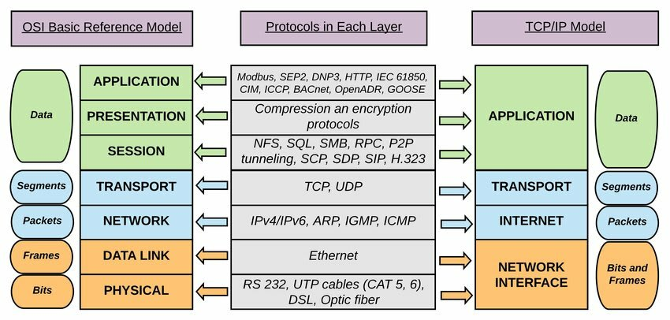
Objectives of today's lesson

Slide 3
Three networking methods to know
Type | Device | Purpose | Scope | Entity | Address | Delivery Method
Wide Area Network | Router | Connected to Internet | Global | Host with an IP address | IP | Forward along network
Local Area Network | Switch | Company/School | Building | Node with a net card | MAC | Forward along network
Local Area Network | Hub | Family | Home | Node with a net card | MAC | Broadcast
Analogy between WAN and postal network
Both sender and receiver must have an address
Hierarchical Address/Zip Code
Collect messages from streets and cities to provinces, and then disperse to cities and streets

Slide 4


Slide 5


Slide 6
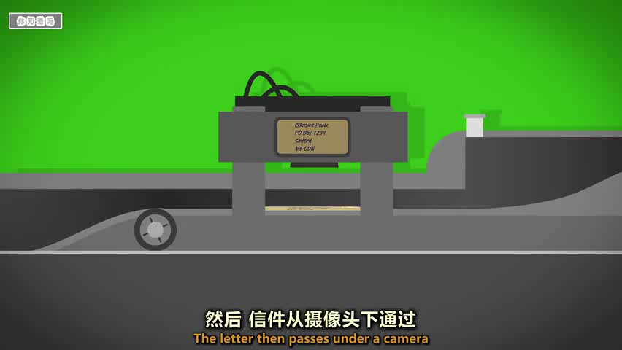

Slide 7
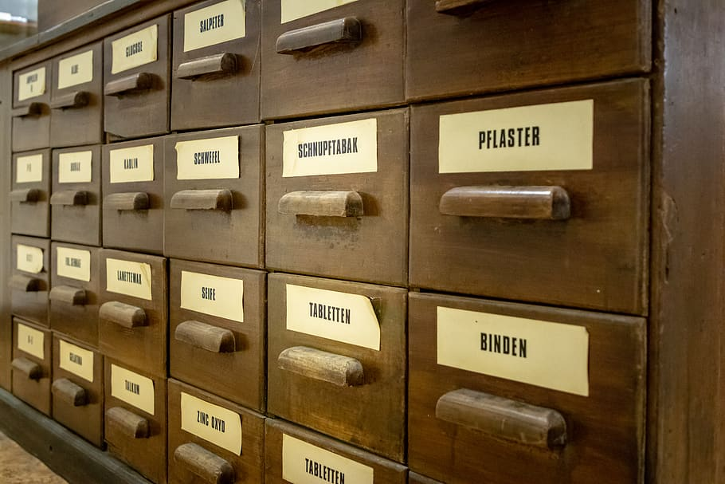
Three networking methods to know
Type | Device | Purpose | Scope | Entity | Address | Delivery Method
Wide Area Network | Router | Connected to Internet | Global | Host with an IP address | IP | Forward along network
Local Area Network | Switch | Company/School | Building | Node with a net card | MAC | Forward along network
Local Area Network | Hub | Family | Home | Node with a net card | MAC | Broadcast
Analogy between LAN by switch and Mailbox
The receiving and sending parties only need to have their names (assuming there are no duplicate names)
Address format: only one level
Forwarding, usually up to two levels

Slide 8

Three networking methods to know
Type | Device | Purpose | Scope | Entity | Address | Delivery Method
Wide Area Network | Router | Connected to Internet | Global | Host with an IP address | IP | Forward along network
Local Area Network | Switch | Company/School | Building | Node with a net card | MAC | Forward along network
Local Area Network | Hub | Family | Home | Node with a net card | MAC | Broadcast
Analogy between LAN by hub and loudspeaker
Broadcast by name without any forwarding

Slide 9
Section
Network layer

Slide 10
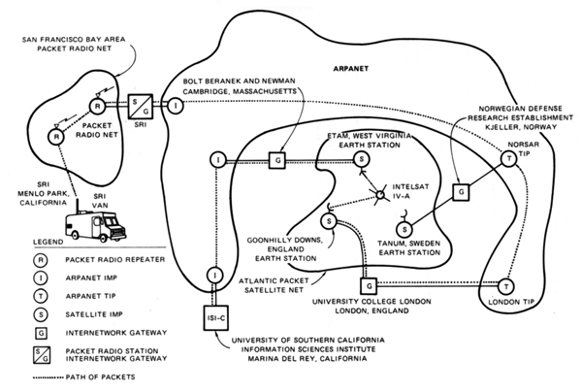
How to design an Internet?
The Inter-net is a global network that comprises many voluntarily interconnected autonomous networks.
Key: TCP/IP Protocol
the first internetworked connection

Slide 11
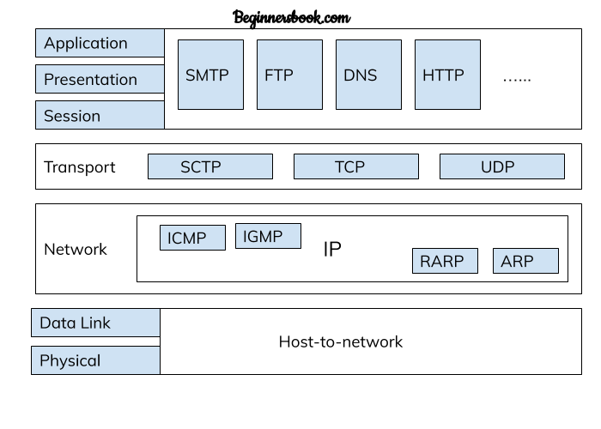
Design goals
Functionality
TCP: connection, connectionless
IP: forwarding and routing
ICMP: control
IGMP: multicast

Slide 12
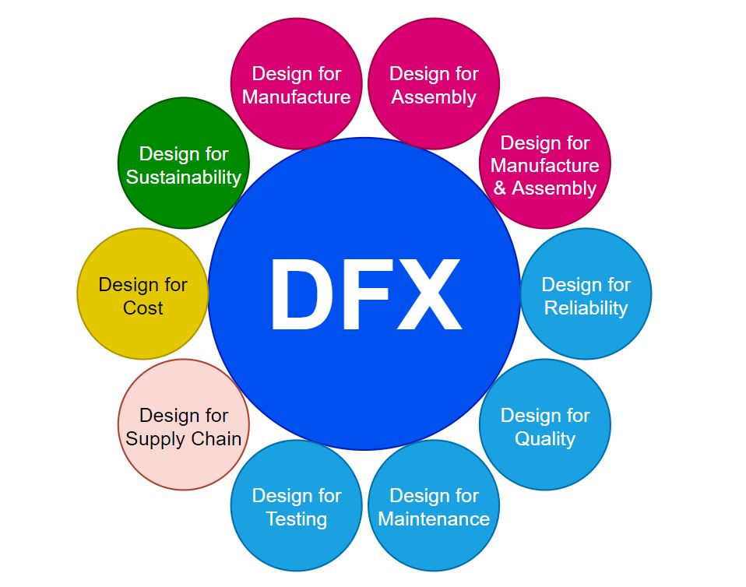
Design goals
Non-Functionality (DFX)
Simplicity：
Only has necessary functions for communication
Does not involve hardware, application

Slide 13
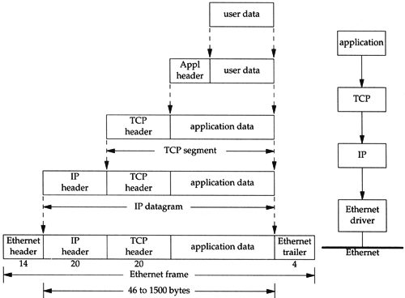
Design goals
Extensibility
In theory, TCP and IP can be independent of each other

Slide 14
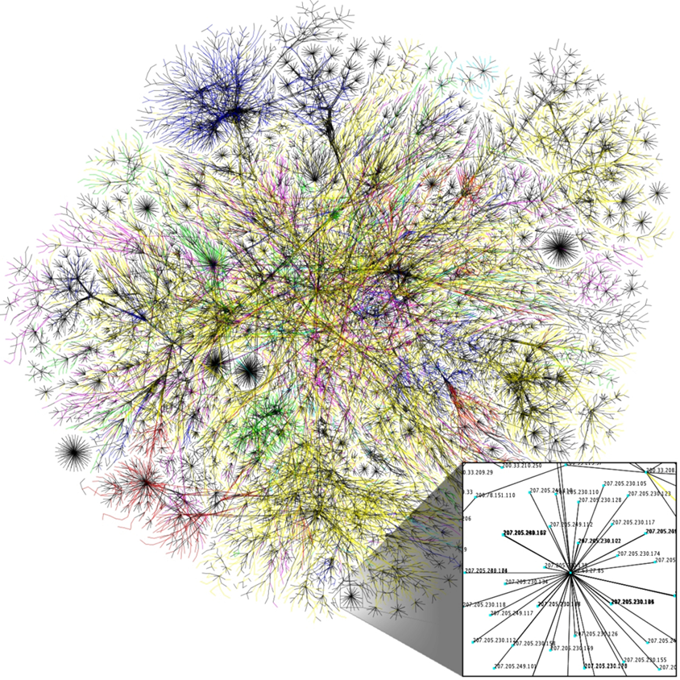
Design goals
Scalability：
Support billions of devices
Performance
Fast Processing
Visualization of Internet routing paths

Slide 15
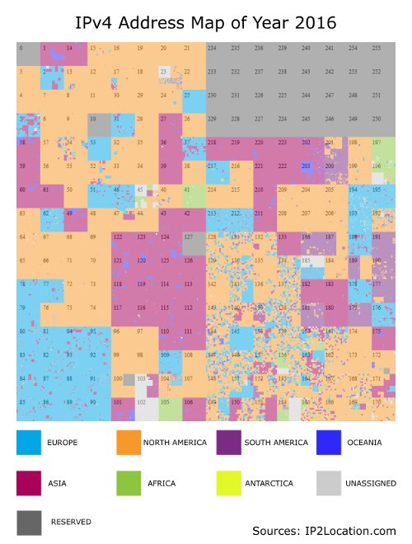
Network layer: forwarding and routing
Differences from postal mail: Digitization
The address and letter format must be standardized Large number of messages and high speed required (80Tbps for a typical router) Address allocation order, which does not imply a geographic hierarchy The address changes dynamically Routing paths are diverse and dynamic

Slide 16
IP Datagram format
32 bits
IP protocol version number
head.
len
type of
service
total datagram
length (bytes)
ver
length
header length(bytes)
“type” of service:
diffserv (0:5)
ECN (6:7)
flgs
fragment
offset
fragmentation/
reassembly
16-bit identifier
time to
live
upper
layer
header
checksum
header checksum
TTL: remaining max hops
(decremented at each router)
source IP address
32-bit source IP address
destination IP address
32-bit destination IP address
upper layer protocol (e.g., TCP or UDP)
overhead
options (if any)
e.g., timestamp, record route taken
20 bytes of TCP
20 bytes of IP
= 40 bytes + app layer overhead for TCP+IP
payload data
(variable length,
typically a TCP
or UDP segment)
Maximum length: 64K bytes
Typically: 1500 bytes or less

Slide 17
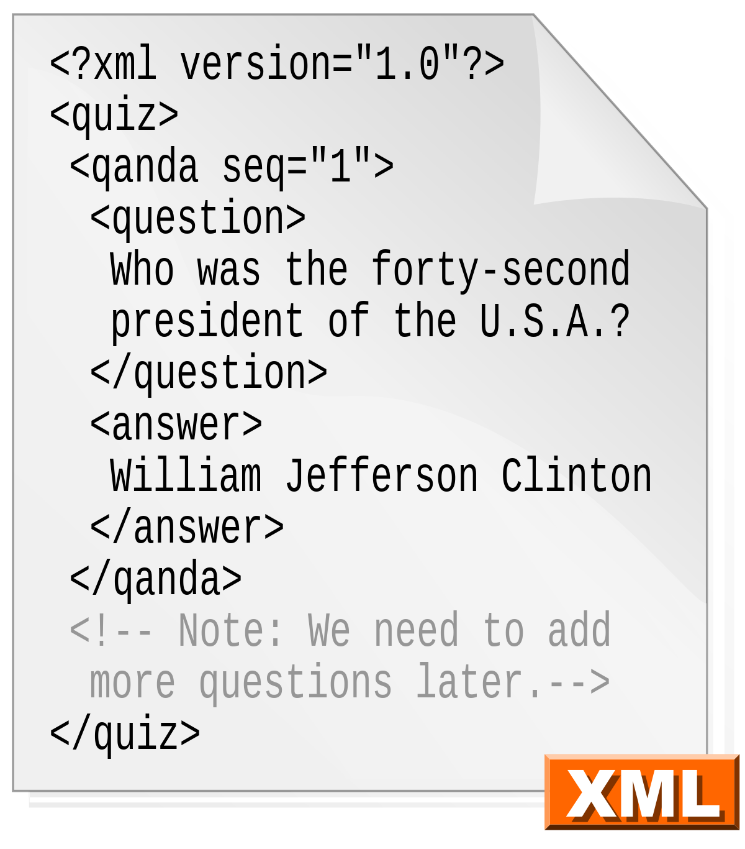
Q:
Why not use XML as the format?

Slide 18
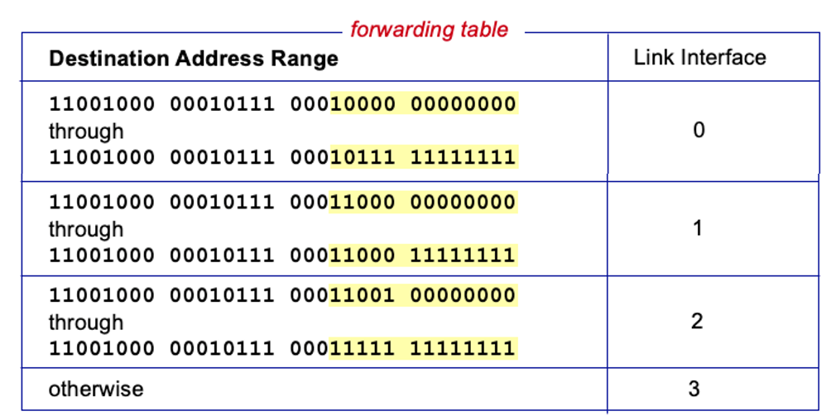
Forwarding table

Slide 19
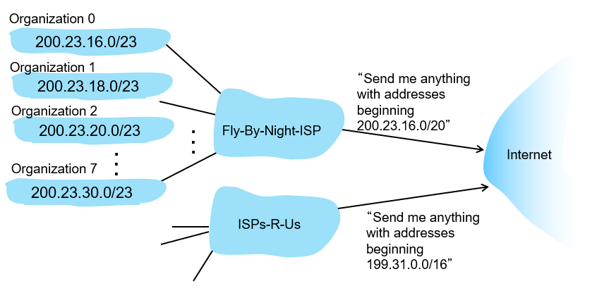
Hierarchical addressing: route aggregation

Slide 20
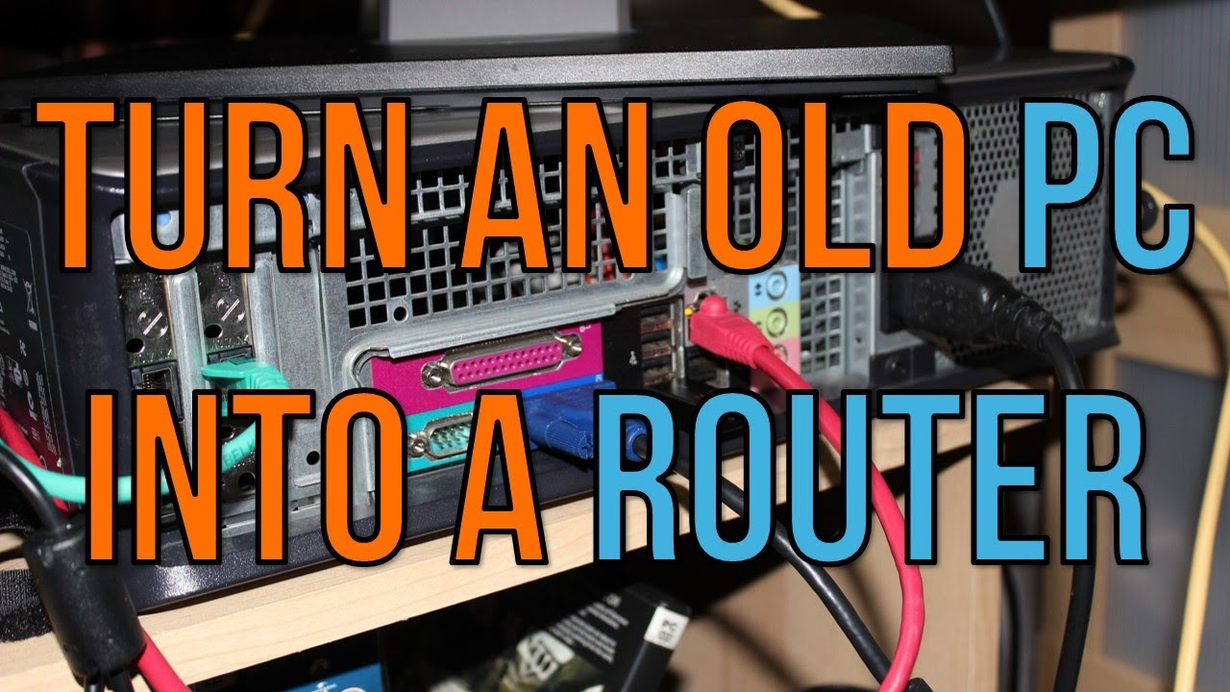
Implementation of router
Knowing the above principle, you can even implement a router with a PC However, as mentioned in Lec. 1, the general von Neumann architecture has slower performance

Slide 21
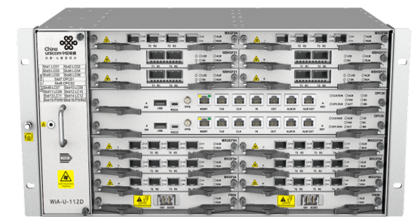
Routers in reality
Note that the wireless router in daily life is actually a link-layer device, not the router mentioned here

Slide 22
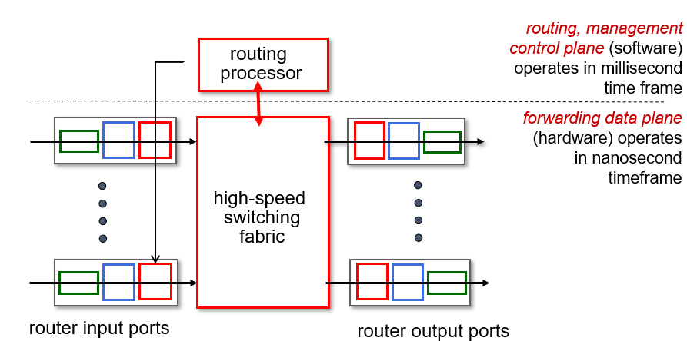
Routers in reality
Input Port: Parses packets and determines the forwarding destination Switch fabric：Message transmission
Output Port: Packet encapsulation

Slide 23
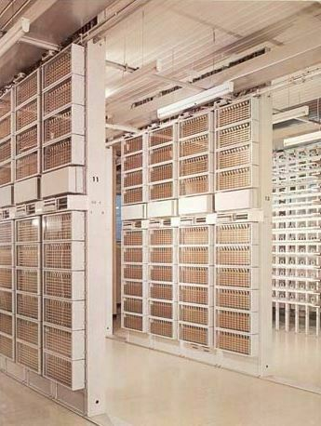
Switching fabrics
memory
interconnection
network
memory
bus
Network inside Network
Mechanical Crossbar

Slide 24
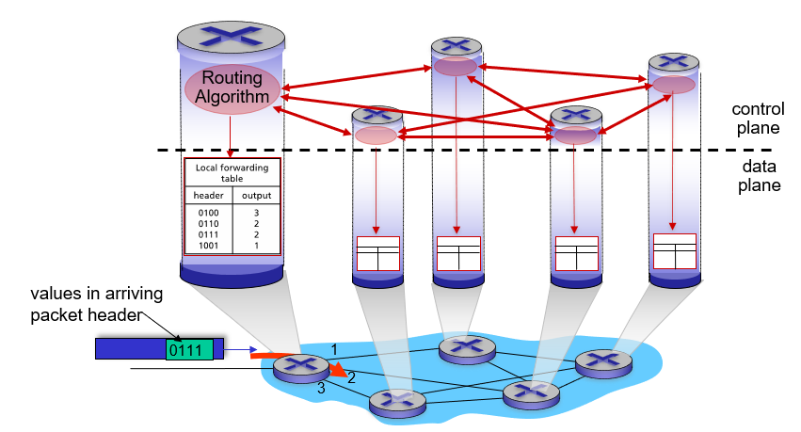
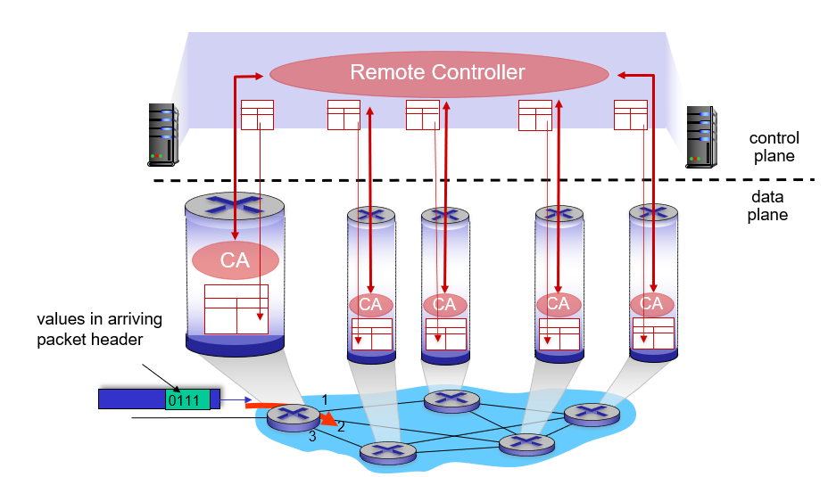
Generation of forwarding table
By exchanging information between routers By a centralized controller
The forwarding table in each router must provide a forwarding destination for all IP addresses; That is, the forwarding table provides a holistic picture of the Internet's connectivity based on a local perspective

Slide 25
Section
Link layer

Slide 26
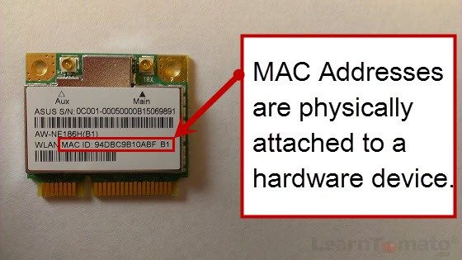
The functionality of the Link layer
There are three phases:
Take responsibility that IP protocol leave blank, but needed to drive the hardware
Error detection, retransmission, etc.
Multiple nodes share a link
Provide a simple, inexpensive way
Link layer switches
Straightforward and easy to use

Slide 27
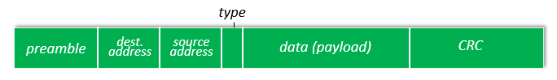
Ethernet datagram
Synchronization, sending and receiving addresses, verification

Slide 28





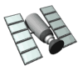




Multiple access links
broadcast (shared wire or medium)
old-fashioned Ethernet
shared wire (e.g.,
cabled Ethernet)
shared radio: 4G/5G
shared radio: WiFi
shared radio: satellite
humans at a cocktail party
(shared air, acoustical)

Slide 29
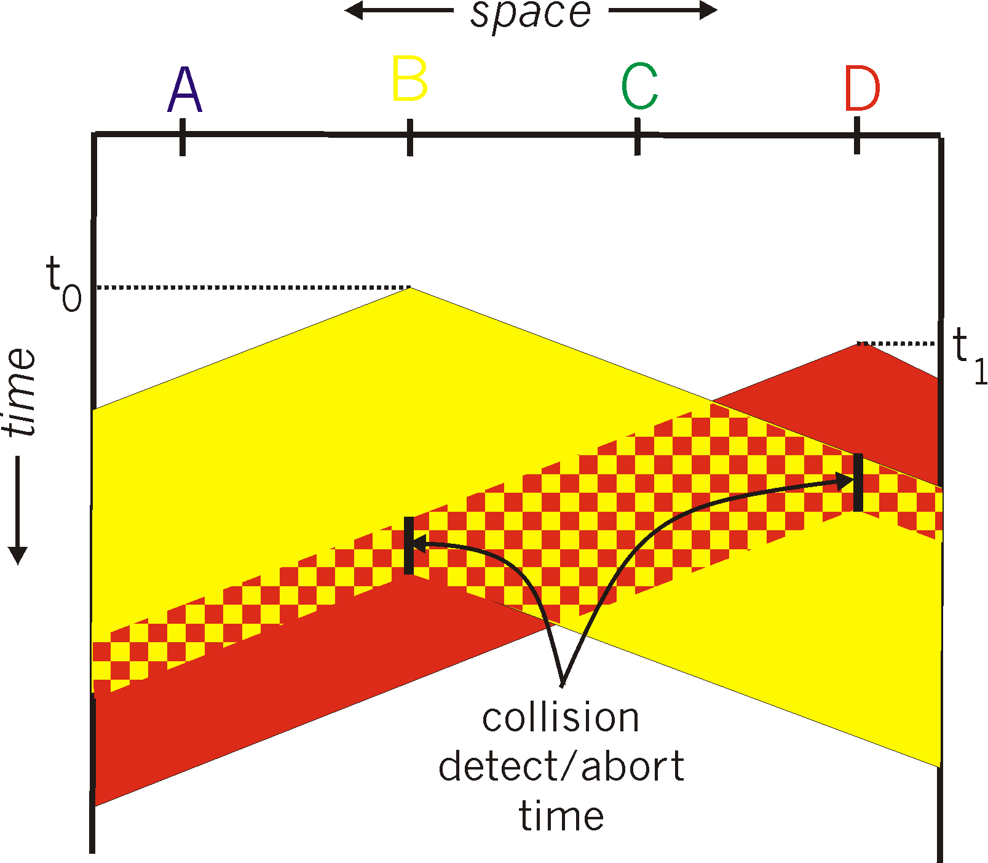
CSMA/CD
Carrier Sense Multiple Access with Collision Detection
Transfer -> Detect Collision -> Wait a random period -> retry

Slide 30
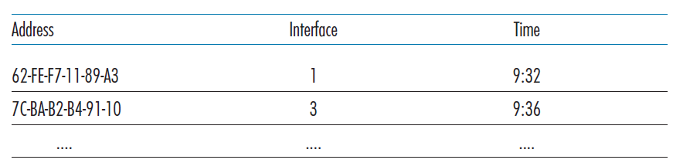
Link layer switch
Forwarding table
Strictly matches the destination address one by one Self-learning capability, no configuration required

Slide 31
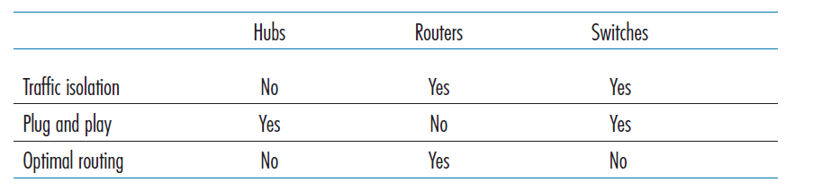
Comparison of devices
Comparison of the typical features of popular interconnection devices

Slide 32
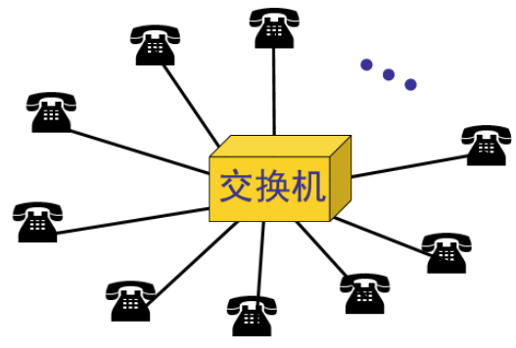

Topology of usual networks
Switch
Switch*
Switch
Switch
Topology
describes how elements of a set relate spatially to each other (wiki)
Star: The simplest structure (* -- linked by a switch with an internal bus)
Tree: Direct contact between two leaves will be slow. For general needs, such as surfing Web, direct contact is rarely required, but it is not for HPC.

Slide 33
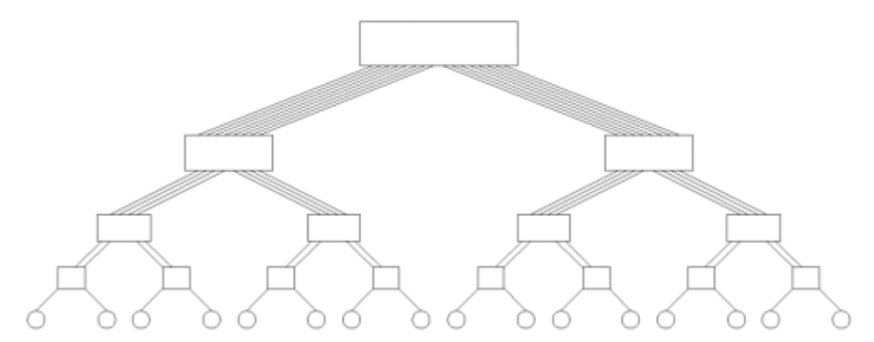
Other possible network structures
Linear
Loop
Fat Tree
Fully Connected
2-D mesh
2-D wraparound mesh
3-D mesh
Balance between cost and performance:
More connections always make communication faster
The higher the number of connections, the higher the cost
Obviously, some structures look more “reasonable” and “connected” than others
How to quantify this concept?

